Slide 1
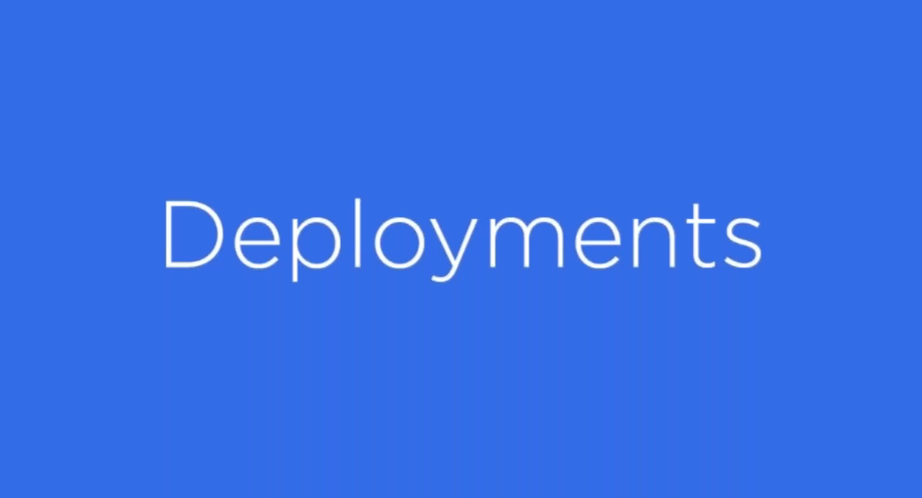

Slide 2
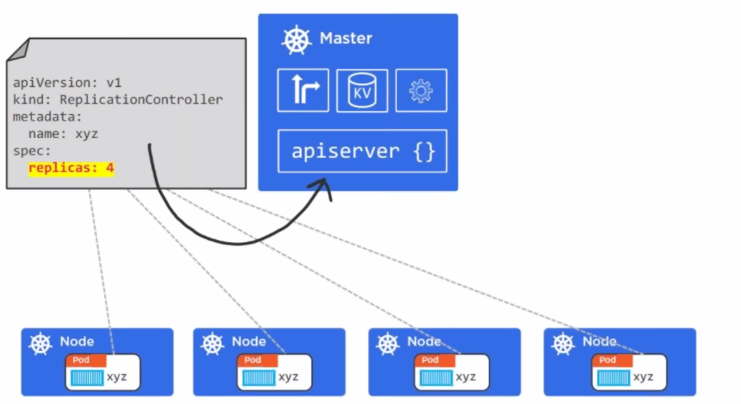

Slide 3
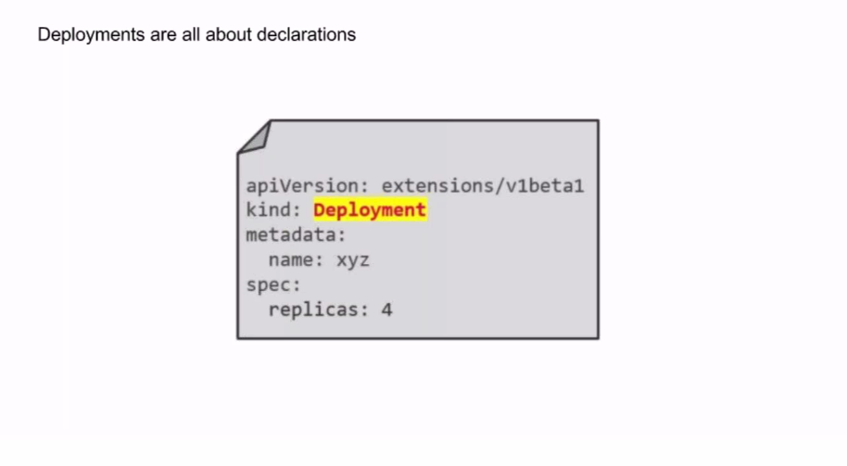

Slide 4
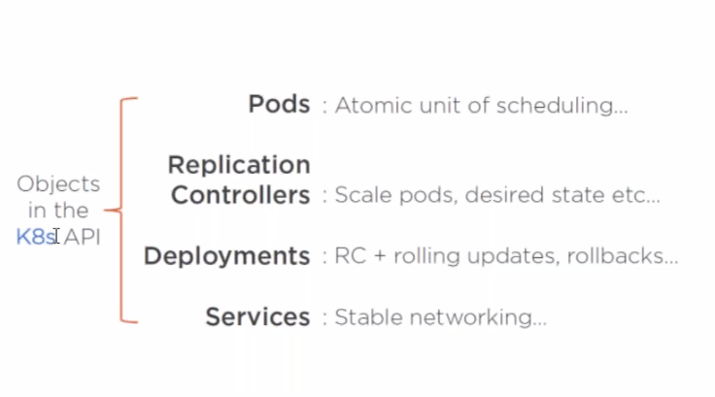

Slide 5
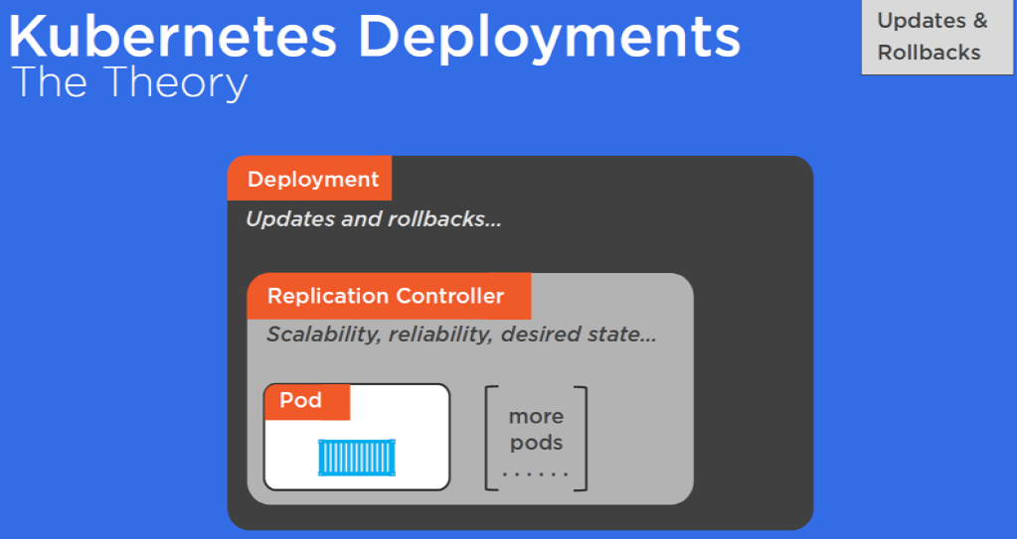

Slide 6
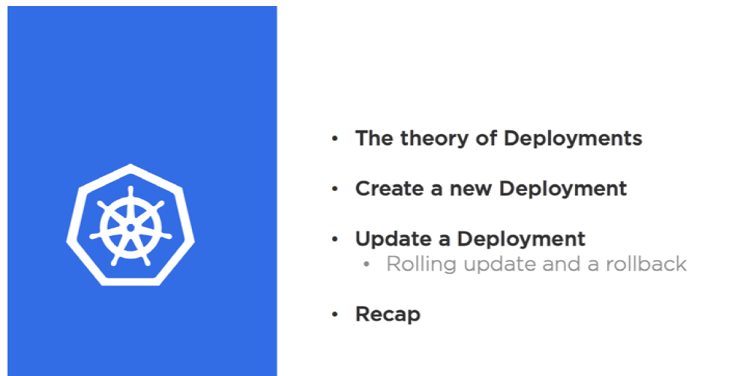

Slide 7
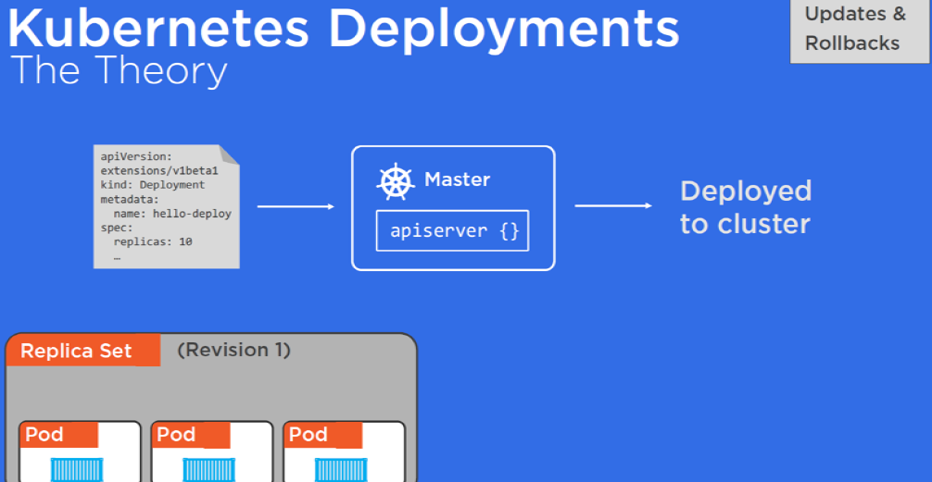

Slide 8
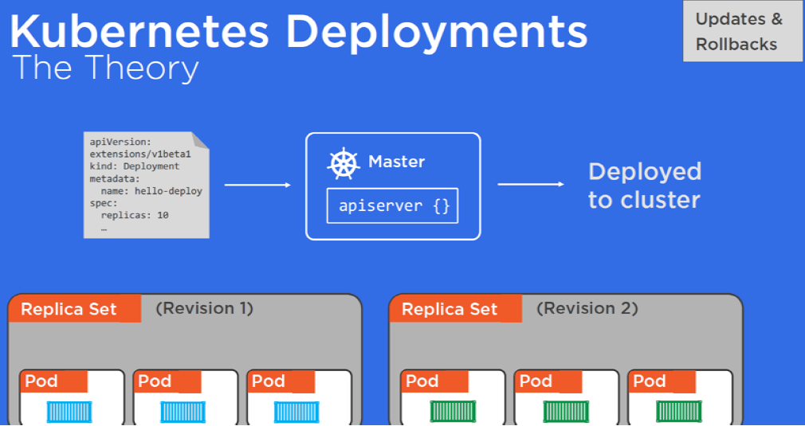

Slide 9
CREATING DEPLOYMENT
Create deploy.yml with following content
apiVersion: extensions/v1beta1
kind: Deployment
metadata:
name: jenkins-deploy
spec:
replicas: 2
minReadySeconds: 2
strategy:
type: RollingUpdate
rollingUpdate:
maxUnavailable: 1
maxSurge: 1
template:
metadata:
labels:
app: jenkins
spec:
containers:
-name: jenkins-pod
image: jenkins
ports:
-containerPort: 8080

Slide 10
CREATING DEPLOYMENT
kubectl create -f deploy.yml
kubectl describe deploy myjavaapp-deploy
kubectl get rs
kubectl describe rs
kubectl get deploy
kubectl delete deploy/myjavaapp-deploy
kubectl delete rs/myjavaapp-deploy-6858bf488c

Slide 11
ROLLING UPDATE TO THE DEPLOYMENT
kubectl apply -f deploy.yml --record
kubectl rollout status deployments myjavaapp-deploy
kubectl get deploy myjavaapp-deploy
kubectl rollout history deployments myjavaapp-deploy
kubectl get rs
`

Slide 12
UNDO ROLLED back
kubectl describe deploy myjavaapp-deploy
kubectl rollout undo deployment myjavaapp-deploy --to-revision=1
kubectl get deploy
kubectl rollout status deployments myjavaapp-deploy
kubectl rollout history deployments myjavaapp-deploy

Slide 13
For Updating:
kubectl --record deployment.apps/myjavaapp-deploy set image deployment.v1.apps/myjavaapp-deploy myjavaapp-container=maha4iac/myonlineapp25oct21:2
kubectl rollout status deployments myjavaapp-deploy
kubectl rollout history deployments myjavaapp-deploy

Slide 14
Rolling Back a Deployment:
kubectl set image deployment.v1.apps/myjavaapp-deploy myjavaapp-container=maha4iac/myonlinebooking:2 --record=true
kubectl rollout undo deployment myjavaapp-deploy --to-revision=1
kubectl rollout status deployments myjavaapp-deploy
kubectl rollout history deployments myapp-deploy

Slide 15
Scaling a Deployment
kubectl scale deployment.v1.apps/myapp-deploy --replicas=3

Slide 16
Pausing and Resuming a Deployment
kubectl rollout pause deployment.v1.apps/myjavaapp-deploy
kubectl set resources deployment.v1.apps/myjavaapp-deploy -c=myjavaapp-container --limits=cpu=200m,memory=512Mi
kubectl rollout resume deployment.v1.apps/myjavaapp-deploy

Slide 17
horizontal Pod autoscaling:
kubectl autoscale deployment.v1.apps/myapp-deploy --min=2 --max=8 --cpu-percent=10
kubectl autoscale deployment myjavaapp-deploy --cpu-percent=10 --min=1 --max=10
kubectl get hpa
kubectl describe hpa
kubectl run -i --tty load-generator --image=busybox /bin/sh
while true: do wget -q -o http://myjavaapp-deploy.default.svc.cluster.local: done
kubectl delete hpa/myjavaapp-deploy

